Slide 1

Exploratory Data Analysis
G2M Insight for Cab Investment Firm
Benjamin Prud’homme
<Date>

Slide 2
Agenda
Executive Summary
Problem Statement
Approach
EDA
EDA Summary
Recommendations

Slide 3
Problem Statement
The Client
XYZ is a private firm in US. Due to remarkable growth in the Cab Industry in last few years and multiple key players in the market, it is planning for an investment in Cab industry and as per their Go-to-Market(G2M) strategy they want to understand the market before taking final decision.
Project delivery:
You have been provided with multiple data sets that contains information on 2 cab companies. Each file (data set) provided represents different aspects of the customer profile. XYZ is interested in using your actionable insights to help them identify the right company to make their investment.
The outcome of your delivery will be a presentation to XYZ’s Executive team. This presentation will be judged based on the visuals provided, the quality of your analysis and the value of your recommendations and insights.

Slide 4
Data Info: Major Observations
Features by table:
Cab_Data.csv: Transaction ID, Date of Travel, Company, City, KM Travelled, Price Charged, Cost of Trip
City.csv: City, Population, Users
Transaction_ID.csv: Transaction ID, Customer ID, Payment_Mode
Customer_ID.csv: Customer ID, Gender, Age, Income (USD/Month)
No missing values found
Date range: 2016-01-01 to 2018-12-30
Features common to multiple tables (joined on these to create one cohesive dataframe in Pandas)
Transaction ID (Cab_Data.csv, Transaction_ID.csv)
City (Cab_Data.csv, City.csv)
Customer ID (Transaction_ID.csv, Customer_ID.csv)
Features added for EDA:
Profit = (Price Charged) – (Cost of Trip)
Day, Weekday, Month, Year
Age Group (18-24, 25-34, 35-44, 45-54, 55-64, 65+)

Slide 5
Data Info: Feature Summary Statistics
Green = Feature joined on to create full dataframe in Pandas
Red = Data type changed manually to match desired value

Slide 6
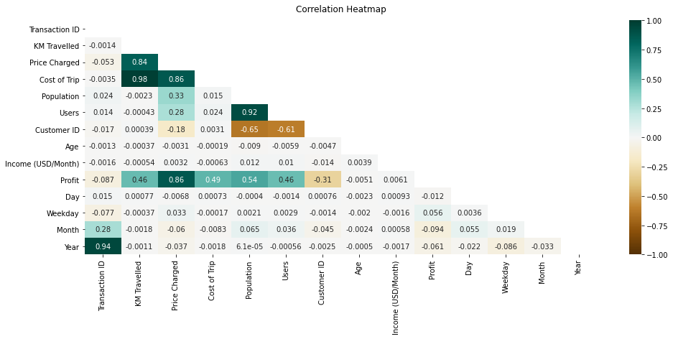
Exploratory Data Analysis 1) Correlation Heatmap
The strongest correlation exists between:
Cost of Trip vs. KM Travelled (0.98)
Users vs. Population (0.92)
Cost of Trip vs. Price Charged (0.86)
Profit vs. Price Charged (0.86)
Price Charged vs. KM Travelled (0.84)
Moderate correlation exists between:
Profit vs. Population (0.54)
Profit vs. Cost of Trip (0.49)
Profit vs. KM Travelled (0.46)
Profit vs. Users (0.46)
Population vs. Price Charged (0.33)
Users vs. Price Charged (0.28)
To answer the research question, we are most interested in investigating the relationship between Profit and other features.

Slide 7
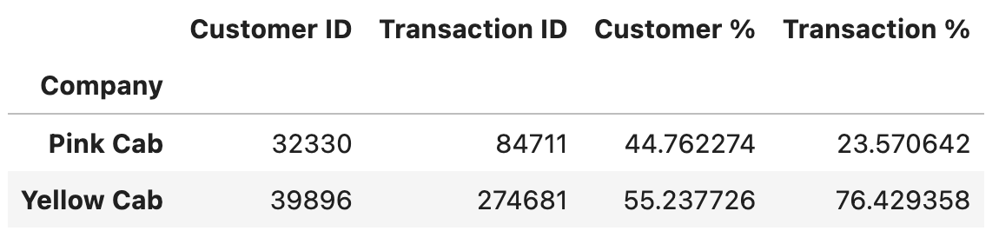
Exploratory Data Analysis 2) Percentage of Customers/Transactions by Company
Yellow Cab is definitely the more popular company
55.24% of all customers ride with them
They processed 76.43% of all recorded transactions, almost 200,000 more than Pink Cab

Slide 8
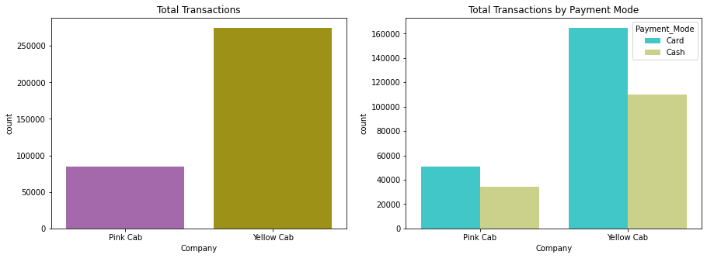
Exploratory Data Analysis 3) Transactions by Payment Method
Card is more popular than cash for both cab companies, but the difference is greater for Yellow Cab
Pink Cab: ~50,000 by card, ~30,000 by cash (difference ~20,000)
Yellow Cab: ~165,000 by card, 110,000 by cash (difference ~55,000)

Slide 9
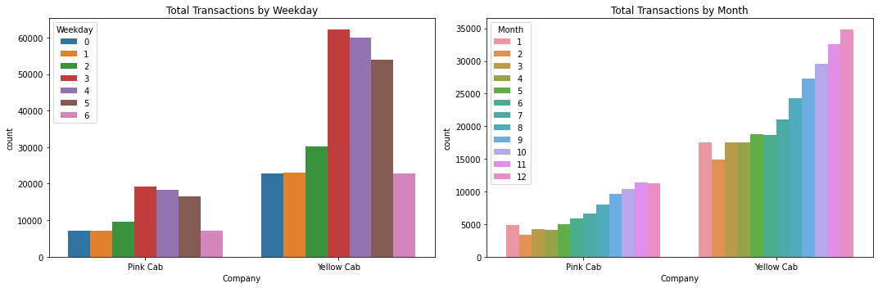
Exploratory Data Analysis 4) Transactions by Weekday/Month
Both companies get a lot more service on Thursdays, Fridays, and Saturdays than on other days
Also, they both experience a similar annual trend:
Service is lowest in February
Service increases throughout the year
Service is highest in December

Slide 10
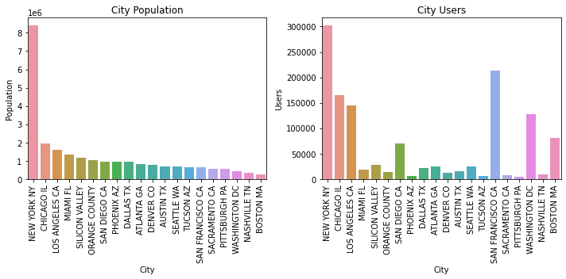
Exploratory Data Analysis 5a) Population vs. Users By City

Slide 11
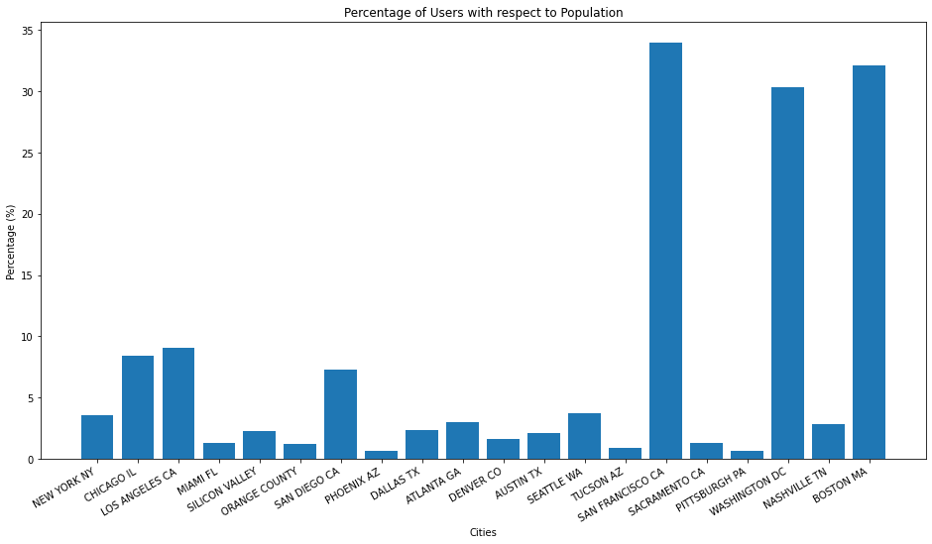
Exploratory Data Analysis 5b) Population vs. Users By City
Although New York has the most people and users, its percentage of people who use either cab company is low.
Also with large numbers of users are Chicago, Los Angeles, San Francisco, Washington DC, and Boston - the latter three of which have high user percentages (30% and up).

Slide 12
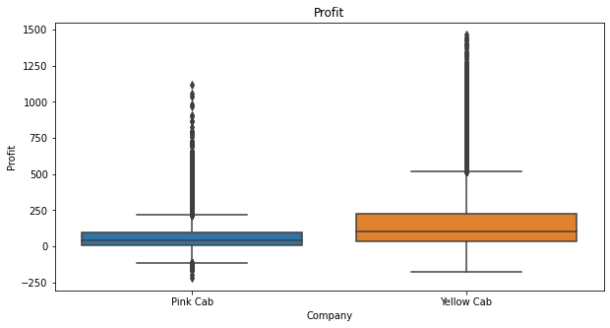
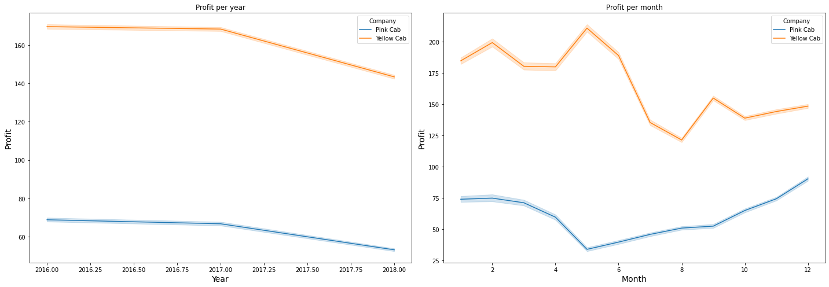
Exploratory Data Analysis 6) Profit Distribution, by Year/Month
On average, Yellow Cab brings in slightly higher profits (average around $150 vs $50 for Pink Cab)
Profits for both companies have declined from 2016 to 2018
Month-wise:
Pink Cab’s profits are highest in Q1 and Q4
Yellow Cab’s profits are highest in Q1 and Q2 (much lower for Q3 and Q4)
Yellow Cab’s profits are consistently higher than those of Pink Cab

Slide 13
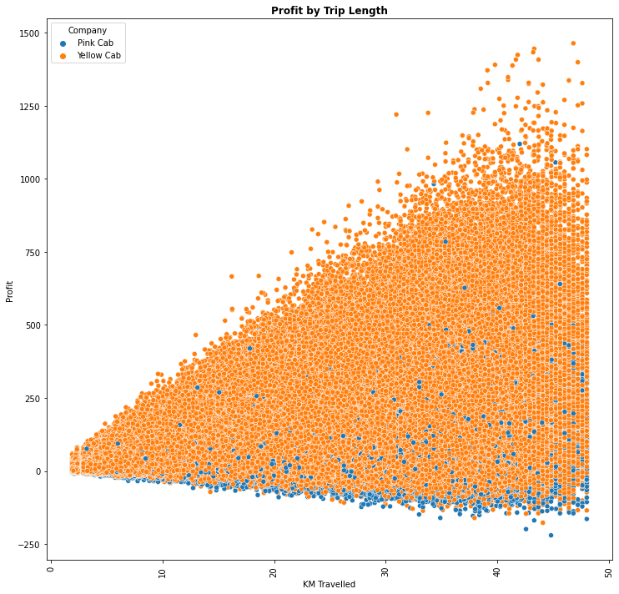
Exploratory Data Analysis 7) Profit by Trip Length
There appears to be a loosely linear relationship between KM Travelled and Profit
Yellow Cab’s profits per ride are slightly higher than those of Pink Cab

Slide 14
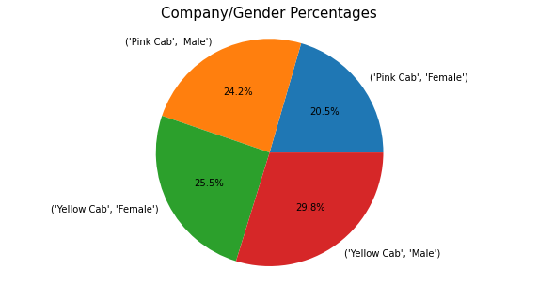
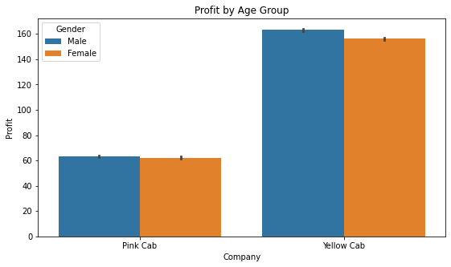
Exploratory Data Analysis 8) Profit vs. Gender
Overall gender percentages: 54% male, 46% female
Company gender percentages match up closely with overall percentages
Pink Cab’s profits are very close for both genders, but Yellow Cab’s profits are about $5 higher for men

Slide 15
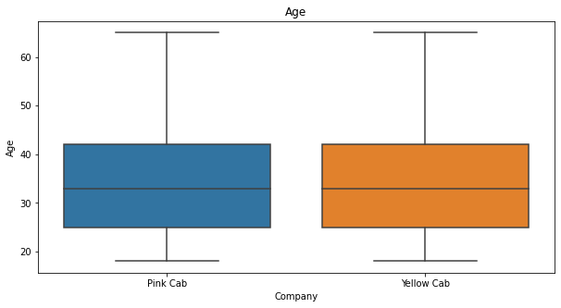
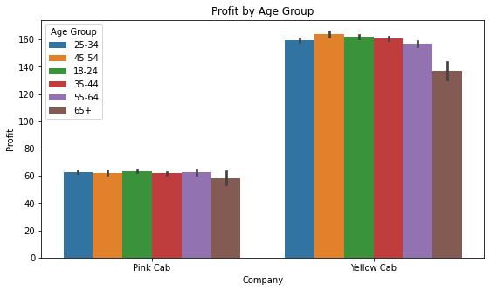
Exploratory Data Analysis 9) Profit vs. Age
Age distributions are nearly identical for the two companies. 75% of riders are ~42 years old or younger.
All age groups bring in about the same profit for Pink Cab (around $60)
All age groups bring in about $160 for Yellow Cab, except those over 65 (closer to $135)
Perhaps Yellow Cab gives discounts to senior citizens on their rides. (Actually, Pink Cab might as well, but theirs is much smaller)

Slide 16
Hypothesis Testing
Profit vs. Gender
Pink Cab: p-value = 0.11 (difference is NOT statistically significant)
Yellow Cab: p-value = 6.06e-25 (difference IS statistically significant)
Profits are higher for men
Profit vs. Age (<65 years vs. >=65 years)
Pink Cab: p-value = 0.12 (difference is NOT statistically significant)
Yellow Cab: p-value = 3.89e-12 (difference IS statistically significant)
Profits are lower for people 65 and older
Profit vs. Business Quarter
Q1-Q2 vs. Q3-Q4
Pink Cab: p-value = 2.09e-52 (difference IS statistically significant – not necessarily expected based on graph on EDA slide 6!)
Profits are a bit higher in Q3-Q4 than Q1-Q2 (means: $65.46 vs. $56.79)
Yellow Cab: p-value = 0 (difference IS statistically significant)
Expectedly, profits are much higher in Q1-Q2
Q1/Q4 vs. Q2/Q3
Pink Cab: p-value = 0 (difference IS statistically significant)
Yellow Cab: p-value = 2.5e-06 (difference IS statistically significant – not necessarily expected based on graph on EDA slide 6!)
Profits are a bit higher for Q2-Q3 than Q1/Q4 (means: $161.92 vs. $158.82)

Slide 17
Recommendations
Generally, I would strongly recommend Yellow Cab for investment.
Even though its profits are declining, they have averaged above $140 for the entire three-year period, while Pink Cab’s profits have never averaged above $100.
It would be most profitable to choose Yellow Cab over Pink Cab during Q2, when Yellow Cab’s profits are highest and Pink Cab’s are lowest.
If investing in Pink Cab, Q4 would be the best time to do it so as to minimize loss: Pink Cab’s profits are highest then, and Yellow Cab’s are lowest.
Focus on cities with the most active cab users. These do NOT always correspond with the most populous cities (Silicon Valley is a prime example of this)
Most users are in: New York, Silicon Valley, Chicago, Los Angeles

Slide 18
Thank You

